Slide 1
Chapter 1
Projects in Contemporary Organizations

Slide 2
Introduction
Rapid growth in project management
In the past, most projects were external
  Building a new skyscraper
  New ad campaign
  Launching a rocket
Growth lately is in internal projects
  Developing a new product
  Opening a new branch
  Improving the services provided
1-<number>

Slide 3
How Project Management Developed
Historical projects
  Tower of Babel
  Egyptian pyramids
  Great Wall of China
The Manhattan Project The Manhattan Project was a research and development undertaking during World War II that produced the first nuclear weapons. It was led by the United States with the support of the United Kingdom and Canada.
Modern credit for the development of project management goes to the military
  Navy’s Polaris program
  NASA’s Apollo space program
  Development of “smart bombs” and “missiles”
1-<number>

Slide 4
How Project Management Developed
Project management has found wide acceptance in industry
It has many applications outside of construction
  Managing legal cases
  Managing new product releases
1-<number>

Slide 5
Projects Tend to be Large
Projects tend to be large
  The Channel Tunnel, or Chunnel
  Denver International Airport
  Panama Canal expansion project
  Three Gorges Dam, China
Projects are getting larger over time
  Flying: balloons → planes → jets → rockets → reusable rockets
The more we can do, the more we try to do
1-<number>

Slide 6
Project Management Also Getting Smaller
More people are seeing the advantages of project management techniques
The tools have become cheaper
The techniques are becoming more widely taught and written about
1-<number>

Slide 7
Three Project Objectives: The “Triple Constraint”
Also referred to as the “Iron Triangle”
  Time
  Cost
  Scope
Time, cost, and performance are all related to a project
1-<number>

Slide 8
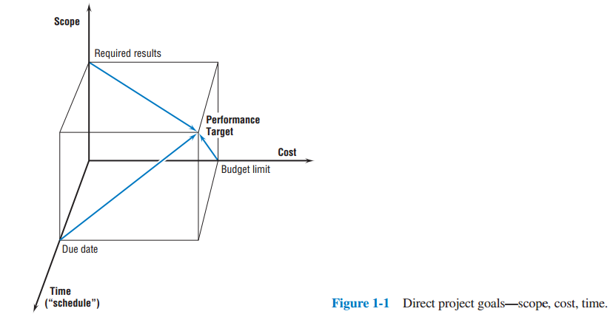
Direct Project Goals: Scope, Cost, Time
1-<number>

Slide 9
The Definition of a “Project”
A temporary endeavor undertaken to create a unique product, service, or result
Modern project management began with the Manhattan Project
In its early days, project management was used mainly for large complex projects
As the tools and techniques were developed, the use of project organization began to spread
1-<number>

Slide 10
Major Characteristics of a Project
Three main
  Unique
  One-time occurrence
  Finite duration
Other
  Interdependencies
  Limited resources
  Conflict
1-<number>

Slide 11
Nonprojects and Quasi-Projects
Routine tasks are not projects
  Ex: production of weekly reports, delivery of mail, etc
Quasi-projects
  Scope, schedule, and budget are implied
1-<number>

Slide 12
Project Success
Project efficiency
Impact on the customer
Business impact on the organization
Opening new opportunities for the future
1-<number>

Slide 13
Project Manager
Project manager is the key individual on a project
Project manager is like a mini-CEO
1-<number>

Slide 14
Why Project Management?
The main purpose for initiating a project is to accomplish some goal
Project management increases the likelihood of accomplishing that goal
Project management gives us someone (the project manager) to spearhead the project and to hold accountable for its completion
1-<number>

Slide 15
Negative Side to Project Management
Greater organizational complexity
Higher probability organizational policy will be violated
Says managers cannot accomplish the desired outcome
Conflict
1-<number>

Slide 16
Forces Fostering Project Management
Main forces in driving the acceptance of project management:
  Exponential growth of human knowledge
  Growing demand for a broad range of complex goods and services
  Increased worldwide competition
All of these contribute to the need for organizations to do more and to do it faster
1-<number>

Slide 17
Recent Changes in Managing Organizations
Consensual management
Systems approach
Projects are established in order to accomplish set goals
1-<number>

Slide 18
Project Management Organizations
The Project Management Institute, founded in 1969, is the major project management organization
Grew from 7,500 members in 1990 to over 450,000 in more than 190 countries by 2017
Other organizations
  Association for Project Management
  International Project Management Association
1-<number>

Slide 19
PMI Certifications
Project Management Professional
Program Management Professional
Portfolio Management Professional
Certified Associate in Project Management
PMI Professional in Business Analysis
PMI Agile Certified Practitioner
PMI Risk Management Professional
PMI Scheduling Professional
1-<number>

Slide 20
Trends in Project Management
Achieving strategic goals
Achieving routine goals
Improving project effectiveness
Virtual projects
Dynamic and quasi-projects
1-<number>

Slide 21
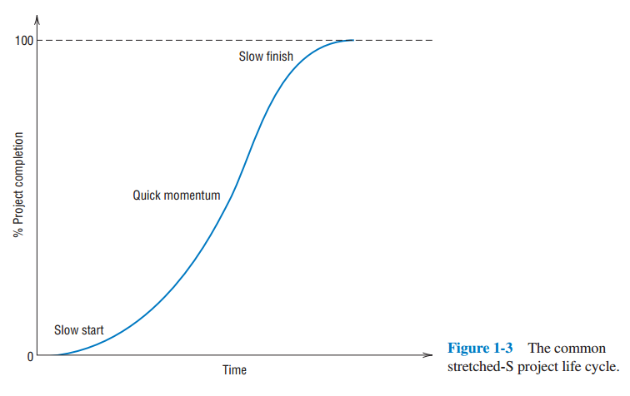
The Project Life Cycle
1-<number>

Slide 22
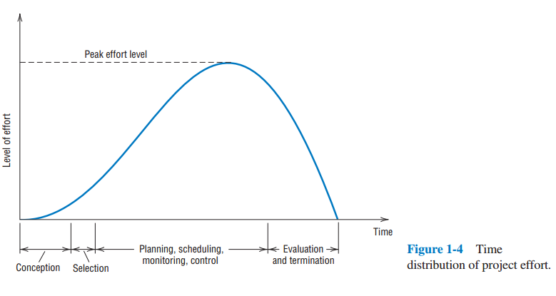
Time Distribution of Project Effort
1-<number>

Slide 23
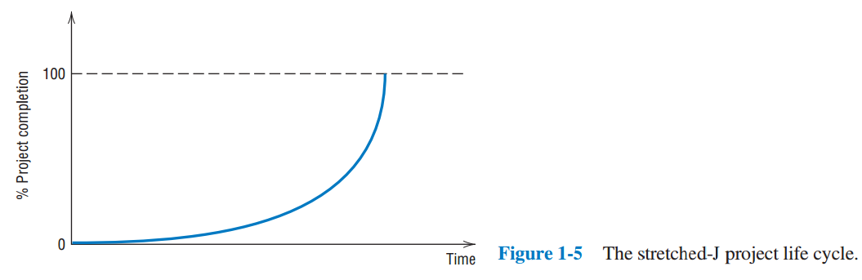
Another Possible Project Life Cycle
1-<number>

Slide 24
Risk
Uncertainty about our ability to meet project goals due to various factors in the project life cycle
1-<number>

Slide 25
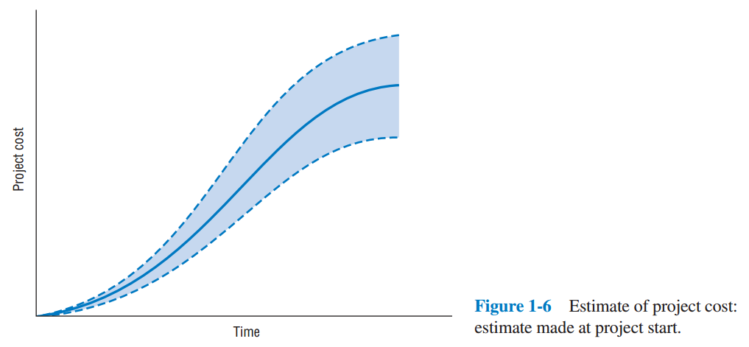
Risk During at the Start of the Life Cycle
1-<number>

Slide 26
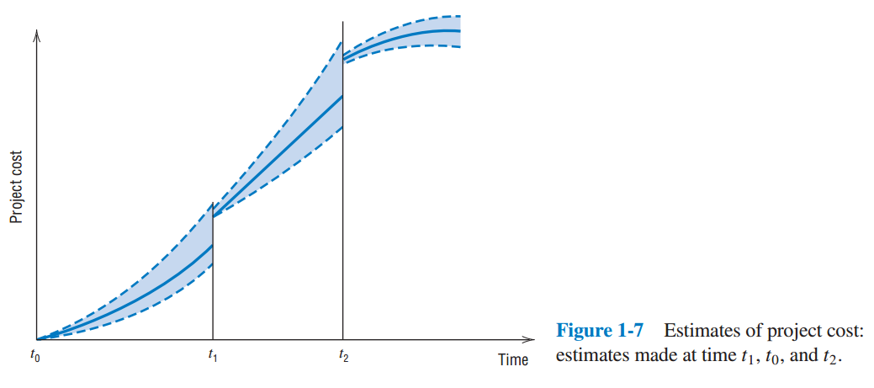
Risk During the Life Cycle
1-<number>

Slide 27
The Structure of this Text
Follows the project life cycle
Some topics stand-alone
Other topics incorporated throughout
1-<number>

Slide 28
Part I: Project Initiation
Projects in Contemporary Organizations
Strategic Management and Project Selection
The Project Manager
Managing Conflict and the Art of Negotiation
The Project in the Organizational Structure
1-<number>

Slide 29
Part II: Project Planning
Project Activity and Risk Planning
Budgeting: Estimating Costs and Risks
Scheduling
Resource Allocation
1-<number>

Slide 30
Part III: Project Execution
Monitoring and Information Systems
Project Control
Project Auditing
Project Closing Out
1-<number>

Slide 31
Copyright
Copyright © 2018 John Wiley & Sons, Inc.
All rights reserved. Reproduction or translation of this work beyond that permitted in Section 117 of the 1976 United States Act without the express written permission of the copyright owner is unlawful. Request for further information should be addressed to the Permissions Department, John Wiley & Sons, Inc. The purchaser may make back-up copies for his/her own use only and not for distribution or resale. The Publisher assumes no responsibility for errors, omissions, or damages, caused by the use of these programs or from the use of the information contained herein.
Copyright ©2017 John Wiley & Son, Inc.

Slide 32
Copyright
Copyright © 2018 John Wiley & Sons, Inc.
All rights reserved. Reproduction or translation of this work beyond that permitted in Section 117 of the 1976 United States Act without the express written permission of the copyright owner is unlawful. Request for further information should be addressed to the Permissions Department, John Wiley & Sons, Inc. The purchaser may make back-up copies for his/her own use only and not for distribution or resale. The Publisher assumes no responsibility for errors, omissions, or damages, caused by the use of these programs or from the use of the information contained herein.
Copyright ©2017 John Wiley & Son, Inc.

